Slide 1
kNN & Naïve Bayes
Hongning Wang
CS@UVa

Slide 2
Today’s lecture
Instance-based classifiers
k nearest neighbors
Non-parametric learning algorithm
Model-based classifiers
Naïve Bayes classifier
A generative model
Parametric learning algorithm

Slide 3
How to classify this document?
Documents by vector space representation
?
Sports
Politics
Finance

Slide 4
Let’s check the nearest neighbor
Are you confident about this?
?
Sports
Politics
Finance

Slide 5
Let’s check more nearest neighbors
Ask k nearest neighbors
Let them vote
?
Sports
Politics
Finance

Slide 6

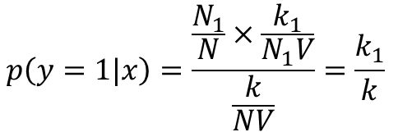
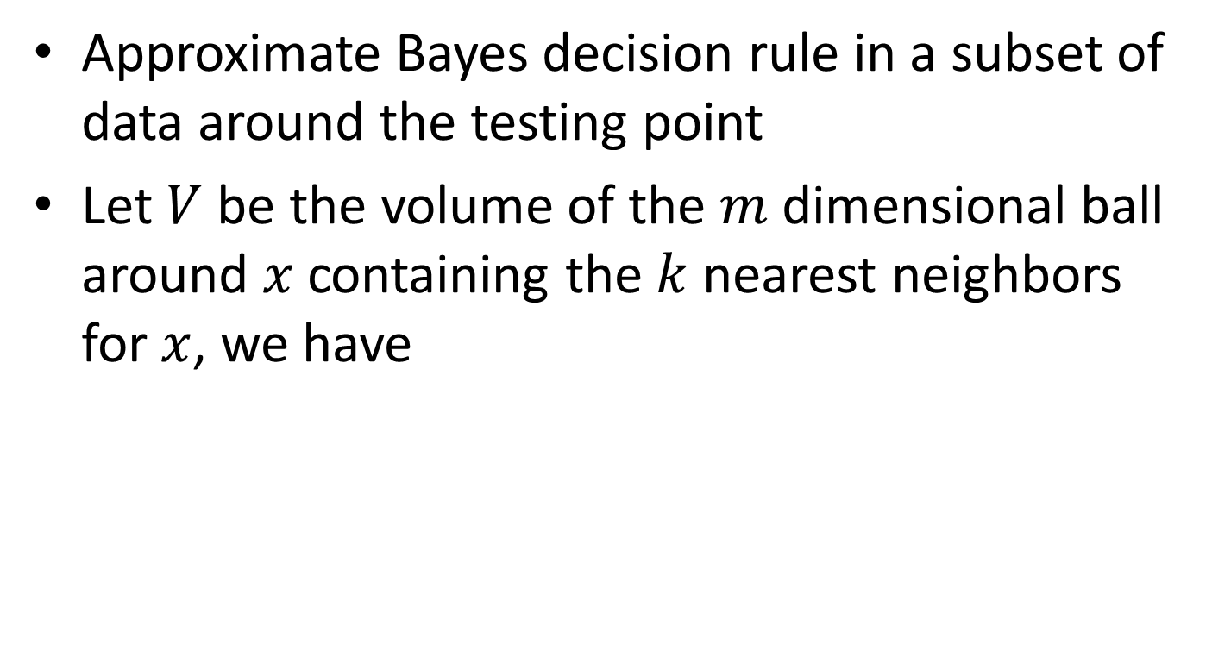



Probabilistic interpretation of kNN
Approximate Bayes decision rule in a subset of data around the testing point
Let $V$ be the volume of the $m$ dimensional ball around $x$ containing the $k$ nearest neighbors for $x$, we have
Nearest neighbors from class 1
$$p\left(x\right)V=\frac{k}{N}$$
$$p\left(x\right)=\frac{k}{NV}$$
$$p\left(x|y=1\right)=\frac{k_{1}}{N_{1}V}$$
$$p\left(y=1\right)=\frac{N_{1}}{N}$$
=>
Total number of instances
With Bayes rule:
Total number of instances in class 1
$$p\left(y=1|x\right)=\frac{\frac{N_{1}}{N}×\frac{k_{1}}{N_{1}V}}{\frac{k}{NV}}=\frac{k_{1}}{k}$$
Counting the nearest neighbors from class1

Slide 7
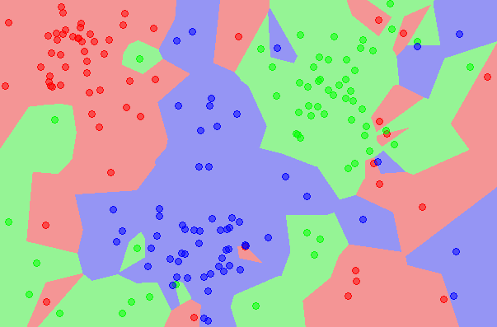
kNN is close to optimal
Asymptotically, the error rate of 1-nearest-neighbor classification is less than twice of the Bayes error rate
Decision boundary
1NN - Voronoi tessellation

Slide 8
Components in kNN
A distance metric
Euclidean distance/cosine similarity
How many nearby neighbors to look at
k
Instance look up
Efficiently search nearby points

Slide 9
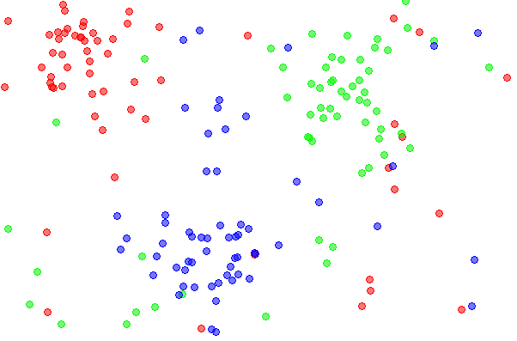
Effect of k
Choice of k influences the “smoothness” of the resulting classifier

Slide 10
Effect of k
Choice of k influences the “smoothness” of the resulting classifier

Slide 11
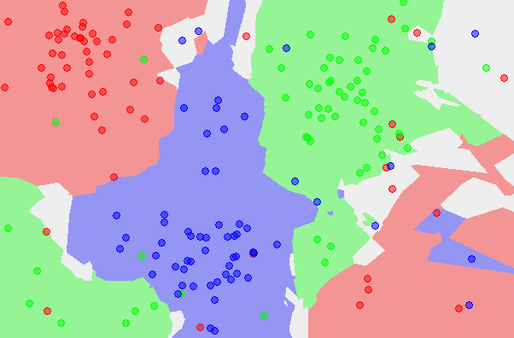
Effect of k
Choice of k influences the “smoothness” of the resulting classifier

Slide 12
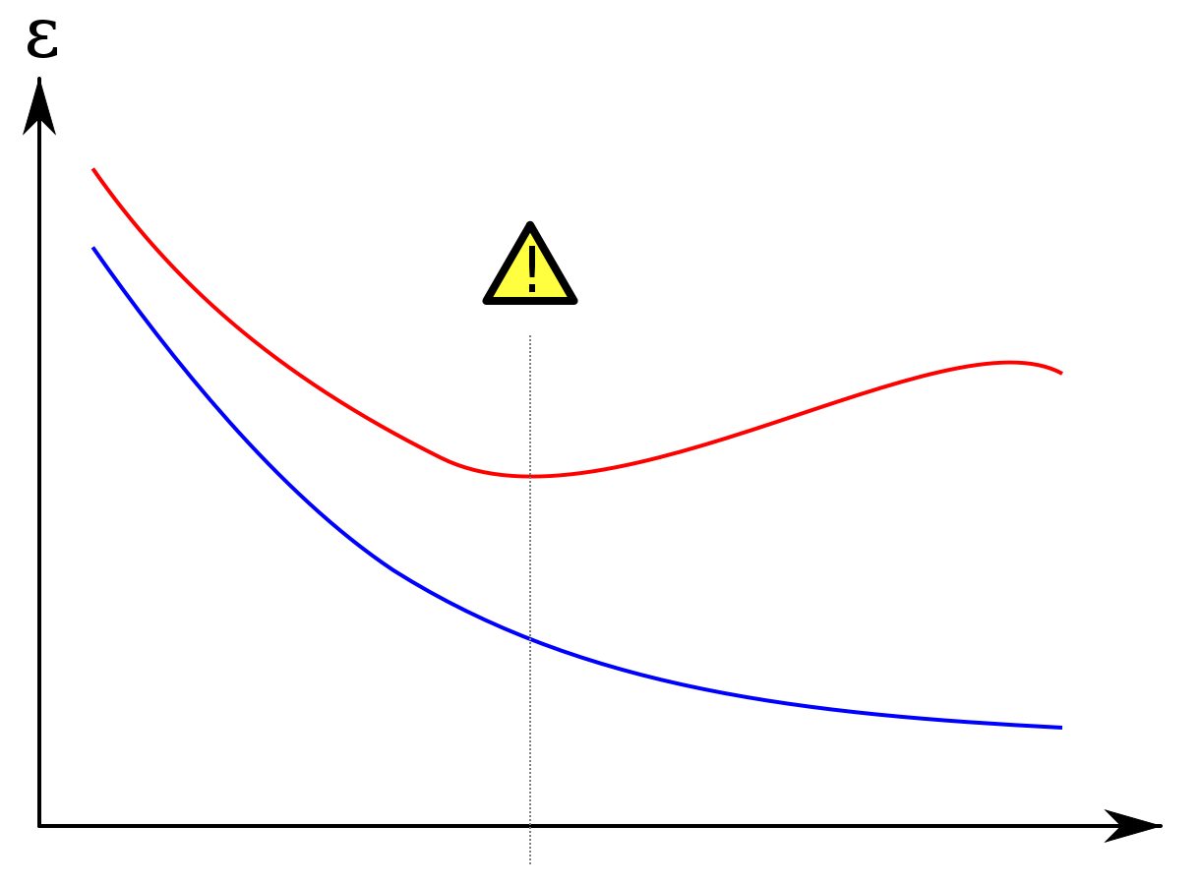
Effect of k
Large k -> smooth shape for decision boundary
Small k -> complicated decision boundary
Error
Error on testing set
Error on training set
Larger k
Smaller k
Model complexity

Slide 13
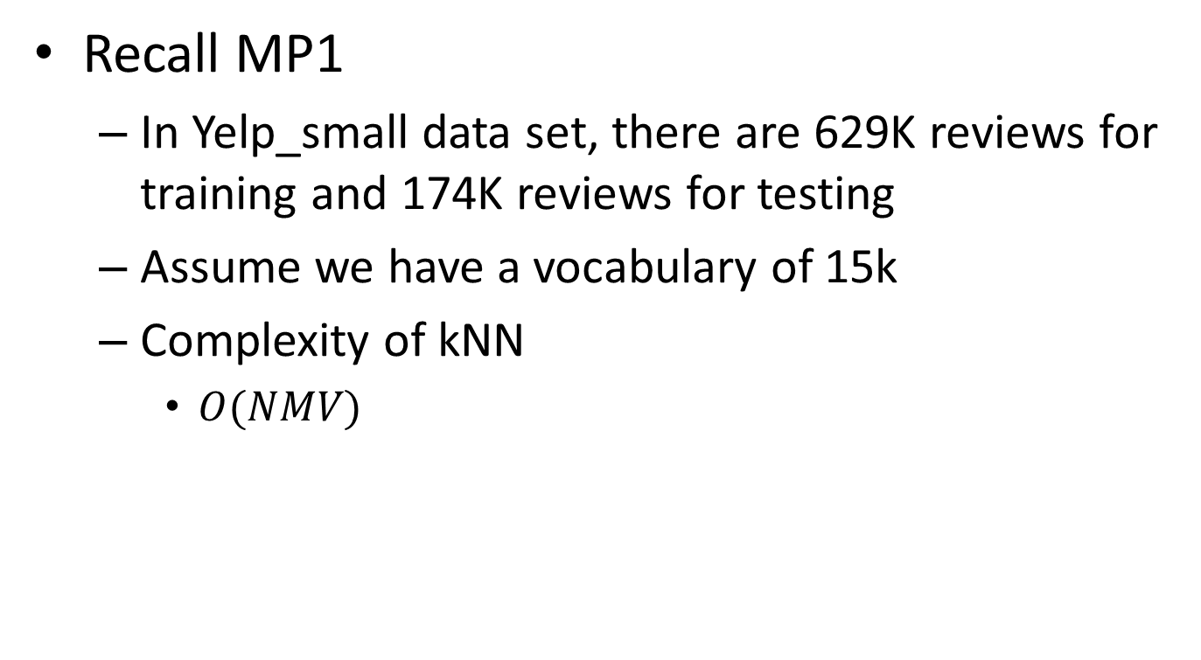
Efficient instance look-up
Recall MP1
In Yelp_small data set, there are 629K reviews for training and 174K reviews for testing
Assume we have a vocabulary of 15k
Complexity of kNN
$O(NMV)$
Feature size
Training corpus size
Testing corpus size

Slide 14
Efficient instance look-up
Exact solutions
Build inverted index for documents
Special mapping: word -> document list
Speed-up is limited when average document length is long
Parallelize the computation
Map-Reduce
Map training data onto different reducers
Merge the nearest k neighbors from the reducers

Slide 15
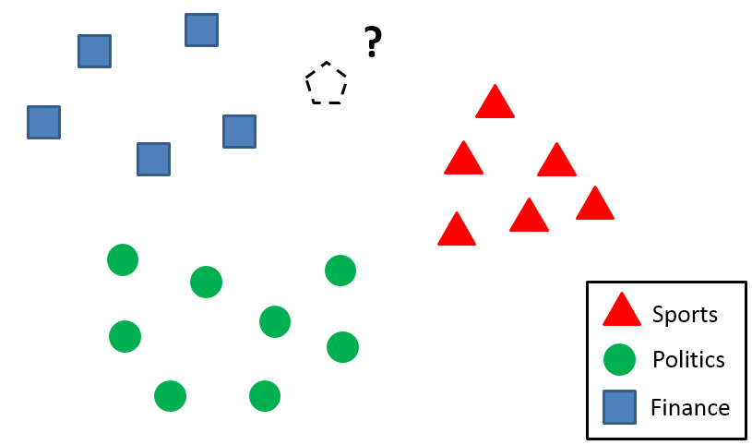

Efficient instance look-up
Approximate solution
Locality sensitive hashing
Similar documents -> (likely) same hash values
h(x)

Slide 16
Efficient instance look-up
Approximate solution
Locality sensitive hashing
Similar documents -> (likely) same hash values
Construct the hash function such that similar items map to the same “buckets” with high probability
Learning-based: learn the hash function with annotated examples, e.g., must-link, cannot link
Random projection

Slide 17







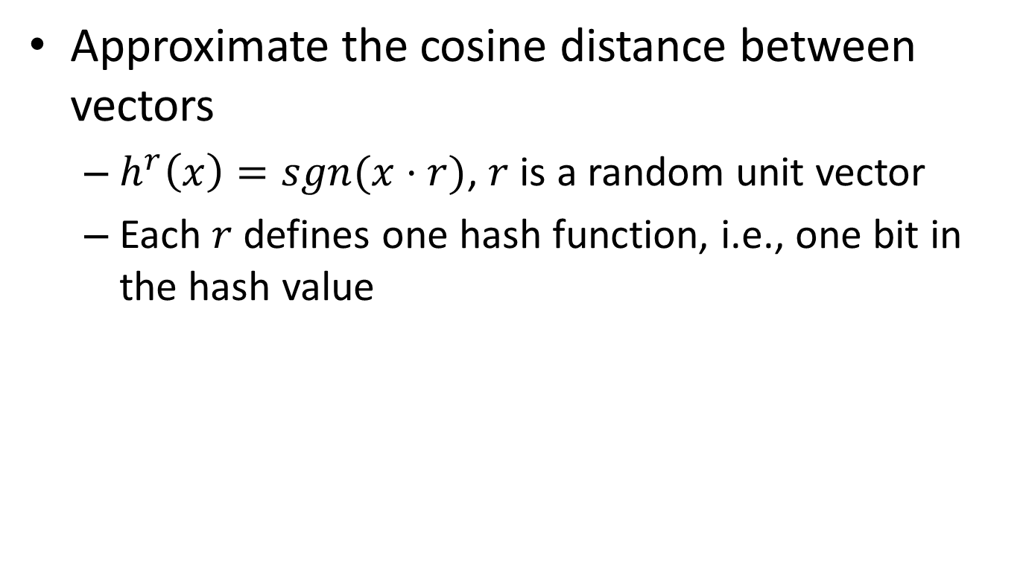










Random projection
Approximate the cosine distance between vectors
$h^{r}\left(x\right)=sgn(x⋅r)$, $r$ is a random unit vector
Each $r$ defines one hash function, i.e., one bit in the hash value
 | 1 | 1 | 0
 | 1 | 0 | 1
$$r_{1}$$
$$r_{2}$$
$$r_{3}$$
$$D_{x}$$
$$D_{y}$$
$$r_{1}$$
$$D_{x}$$
$$D_{x}$$
$$D_{x}$$
$$θ$$
$$θ$$
$$θ$$
$$r_{2}$$
$$D_{y}$$
$$D_{y}$$
$$D_{y}$$
$$r_{3}$$

Slide 18








Random projection
Approximate the cosine distance between vectors
$h^{r}\left(x\right)=sgn(x⋅r)$, $r$ is a random unit vector
Each $r$ defines one hash function, i.e., one bit in the hash value
 | 1 | 0 | 1
 | 1 | 0 | 1
$$r_{1}$$
$$r_{2}$$
$$r_{3}$$
$$D_{x}$$
$$D_{y}$$
$$r_{1}$$
$$D_{x}$$
$$D_{x}$$
$$D_{x}$$
$$θ$$
$$θ$$
$$r_{2}$$
$$θ$$
$$D_{y}$$
$$D_{y}$$
$$D_{y}$$
$$r_{3}$$

Slide 19
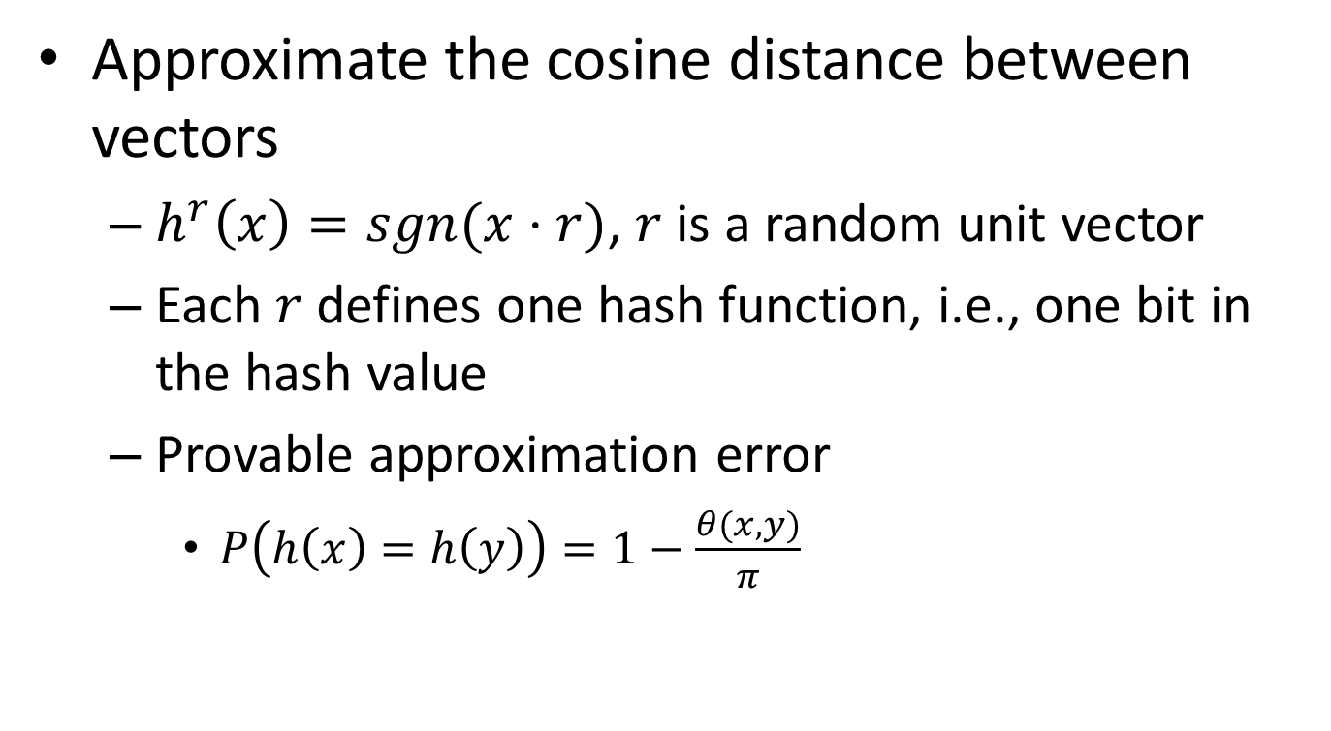
Random projection
Approximate the cosine distance between vectors
$h^{r}\left(x\right)=sgn(x⋅r)$, $r$ is a random unit vector
Each $r$ defines one hash function, i.e., one bit in the hash value
Provable approximation error
$P\left(h\left(x\right)=h\left(y\right)\right)=1−\frac{θ(x,y)}{π}$

Slide 20
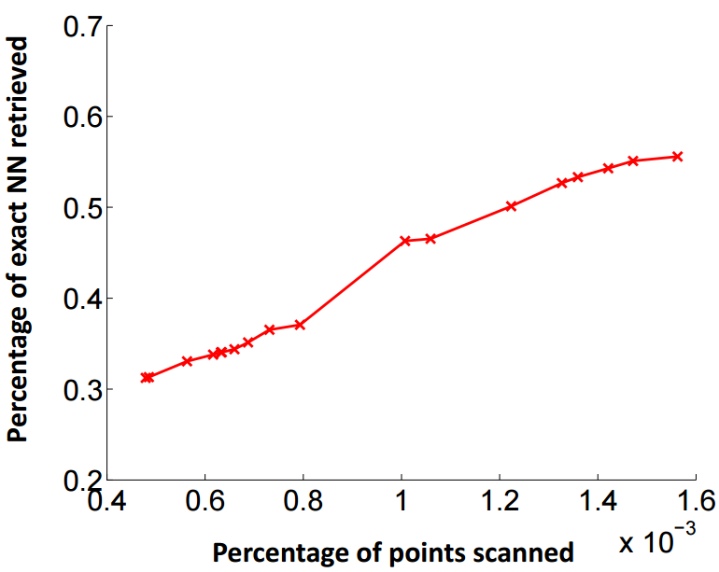
Efficient instance look-up
Effectiveness of random projection
1.2M images + 1000 dimensions
1000x speed-up

Slide 21
Weight the nearby instances
When the data distribution is highly skewed, frequent classes might dominate majority vote
They occur more often in the k nearest neighbors just because they have large volume
?
Sports
Politics
Finance

Slide 22
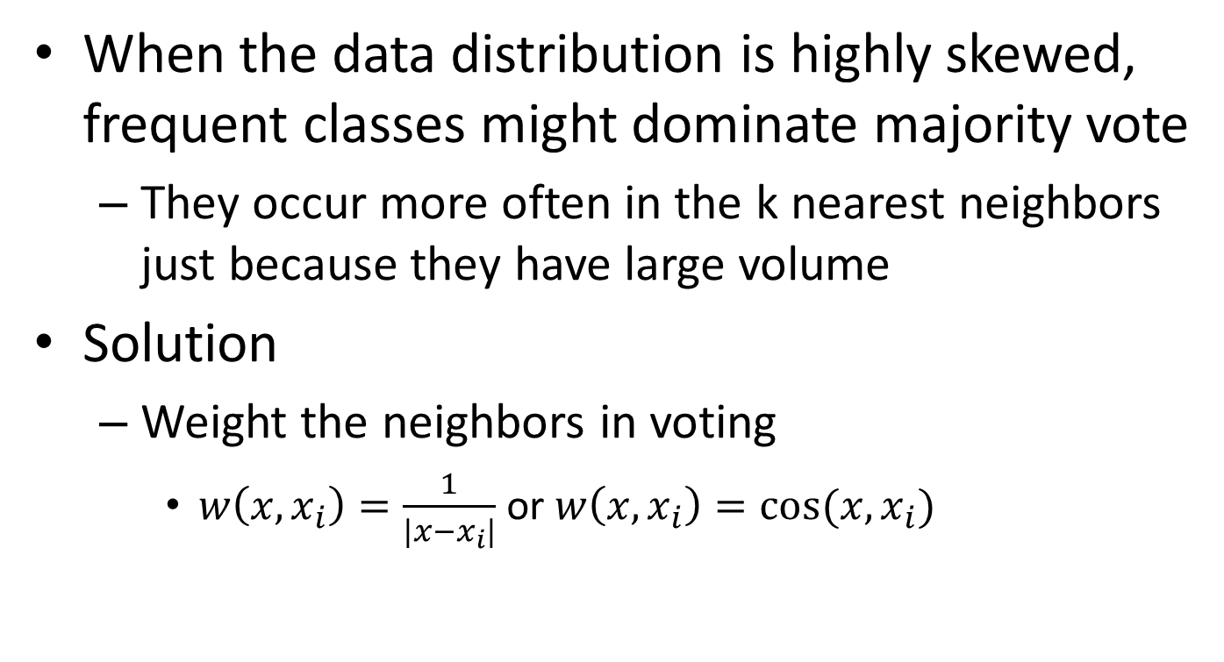
Weight the nearby instances
When the data distribution is highly skewed, frequent classes might dominate majority vote
They occur more often in the k nearest neighbors just because they have large volume
Solution
Weight the neighbors in voting
$w\left(x,x_{i}\right)=\frac{1}{|x−x_{i}|}$ or $w\left(x,x_{i}\right)=cos⁡(x,x_{i})$

Slide 23
Summary of kNN
Instance-based learning
No training phase
Assign label to a testing case by its nearest neighbors
Non-parametric
Approximate Bayes decision boundary in a local region
Efficient computation
Locality sensitive hashing
Random projection

